Slide 1
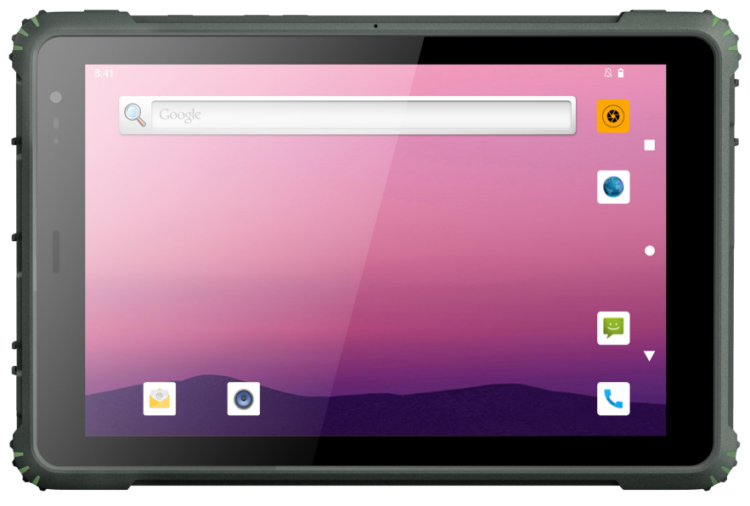
TPC-GS109M2A
10.1'' MTK MT6789 2.2GHz
Rugged Tablet
Features:
■ 10.1'' WXGA (1280 x 800) 1000 nits TFT LCD
■ MT6789, 2 ARM® Cortex-A76 2.2 GHz+6 ARM® Cortex-A55 2.0 GHz
■ WIFI6 802.11 (a/b/g/n/ac/ax), Bluetooth 5.2
■ Optional 1D/2D barcode scanning, NFC/RFID
■ Supports GPS/BeiDou/Glonass/Galileo
■ Corning Gorilla third-generation glass, optional with AG+AF+wet hand/glove touch
■ 9800mAh high capacity battery meets the requirements of long-term operation
■ Standard IP65, optional IP67
■ Android 13
Specifications:
System Hardware
CPU RAM+Storage Camera Flash Light Speaker | MT6789, 2 ARM® Cortex-A76 2.2 GHz + 6 ARM® Cortex-A55 2.0 GHz 8GB+128GB Front 8MP fixed focus camera, rear 20MP autofocus camera support Single speaker, 1.2W/8 Ω aluminum film, IP67 waterproof speaker | MIC Earpiece Button LED Indicator Sensor | IP67 waterproof microphone IP67 waterproof earpiece Power button, Volume +/-, 1*Customize function key 1*Barcode scanner shortcut key Charging indicator G­sensor, Gyroscope, geomagnetism, Distance sensor, Motor, Light sensor, air pressure
Display
LCD Type Max. Resoltuion Cover Glass | 10.1" TFT-LCD 1280*800 Corning Gorilla third-generation glass, with a hardness of 7H and a light transmittance of 85% | Luminance Touchscreen | 1000 cd/m² 5-point capacitive touch screen Optional AG+AF or AG+AF+wet hands/gloves
OS
OS | Android 13
I/O Interface
POGO PIN USB Video Audio | 1*POGO PIN (USB+charging) 1*USB Type C (USB OTG+charging) 1*USB 2.0, TYPE A 1*mini HD 3.5mm headphone jack | DC Jack SIM Card Slot TF Card Slot Aviation Plug | 1*DC Jack 1*Micro SIM card holder 1*TF card holder, supporting up to 256GB Extension 1*COM or 1*USB2.0
+86 0755 86164919
www.geshemtech.com

Slide 2
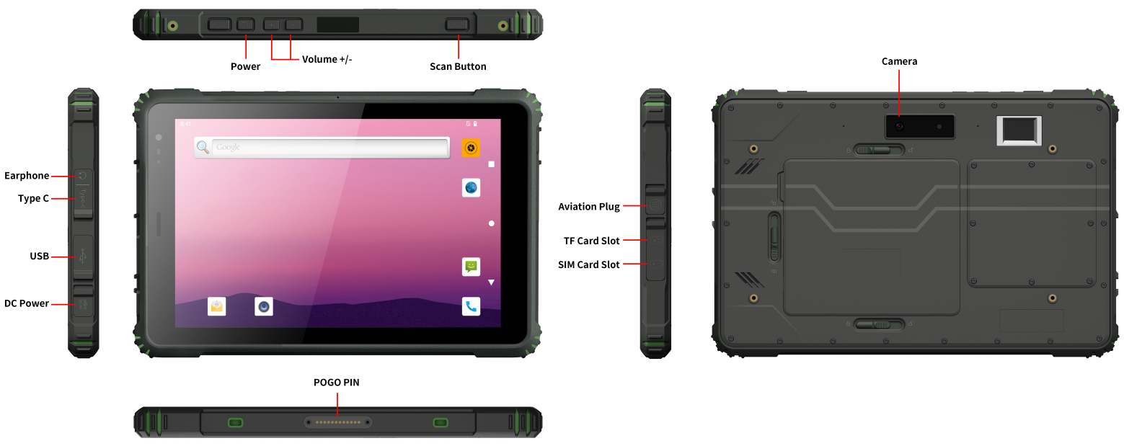
TPC-GS109M2A
Network Communication
WWAN | 2G/3G/4G multimode, Carrier Aggregation (CA), EDGE, FDD/TDD LTE, 5G FDD/TDD, GSM, TD-SCDMA, WDCDMA GSM: B2/3/5/8 TD-SCDMA: B34/B39 WCDMA: B1/2/5/8 CDMA: BC0 TDD: 34/38/39/40/41 FDD: 1/2/3/4/5/7/8/12/17/18/19/20/25/26/28A/28B/66 | WIFI Bluetooth GNSS | Wi Fi 6 (a/b/g/n/ac/ax) Bluetooth 5.2 GPS L1CA+L5/Beidou B1I+B2a/Glonass L1OF/Galileo E1+E5a/QZSS L1CA+L5/NaviC
Extended Functions
NFC RFID | 13.56MHz, supporting 14443A/14443B/15693 Optional RFID/HF RFID/UHF RFID | ID Card Identification Barcode Scanner | Optional ID card recognition module Optional 1D/2D barcode scanning
Power
Power Input | 5V DC input, standard with 5V/2A power adapter Optional 5-24V DC power input, without built-in battery power supply | Battery Battery Life | 9800mAh, 3.8V detachable lithium battery 10 hours (LCD 50% brightness, playing 1080P video)
Environment
Drop IP Rating Operating Temp. Storage Temp. | 1.2m free fall to the wooden floor Standard IP65, optional IP67 -10℃~50℃ Storage temperature: -30~70℃ (excluding batteries); -20~50℃(Including batteries, needs to be charged and discharged once within 2 months of long-term storage)
Certificate
Certificate | CE、ROHS、UN38.3、MSDS、IEC62133
Mechanical
Dimension (WxHxD) | 272*180*21mm Increase the thickness of the optional UHF RFID module by 9.5mm | Weight Color | 1.25kg Black
Accessory
Accessory Optional Accessory | Hand strap, 5V/2A power adapter Docking, Vehicle bracket, Vehicle charger, Passive touch pen, Type-C data cable, Type-C OTG cable
Product Six Views:
+86 0755 86164919
www.geshemtech.com

